Slide 1


COURSE MATERIAL
Course : 23CSC04 – Principles of Compiler Design
Module : 2 - Semantic Analysis and Intermediate Code Generation
Topic : Intermediate Code Generator: Intermediate Languages, Three Address Code
Faculty : Ms. G. Vidyasree
www.skcet.ac.in

Slide 2
Intermediate Code Generation
Interface between front-end and back-end in compiler
Intermediate Languages
Two kinds of Intermediate representation:
Syntax Tree
Postfix notation
Graphical Representations
Syntax Tree
Hierarchical structure of source program
DAG : Identify common subexpressions

Slide 3
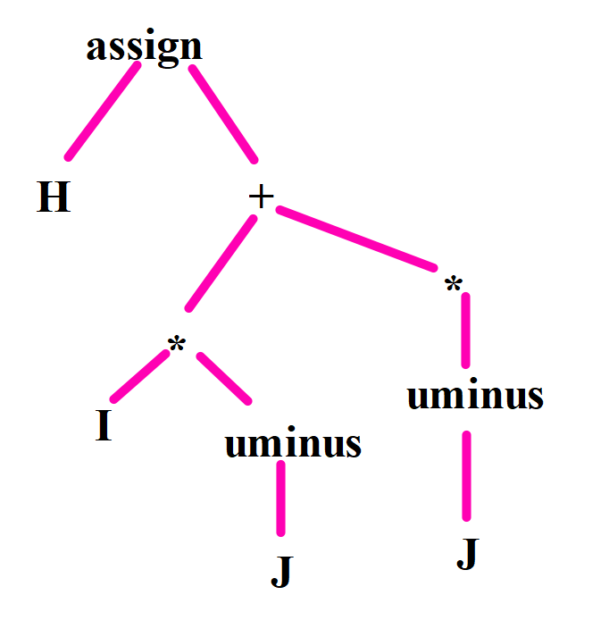
Graphical representation of H:= I *- J + I * - J
Syntax Tree

Slide 4
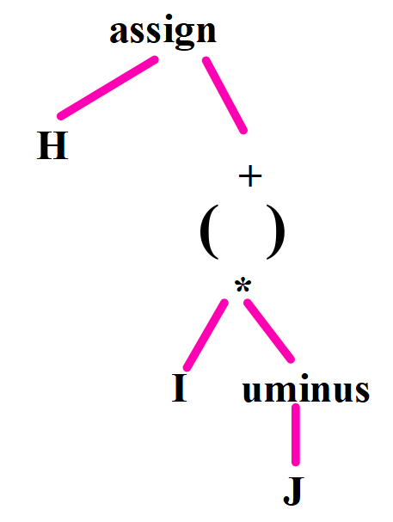
DAG: Directed Acyclic Graph
Postfix notation is linearized representation of syntax tree
It’s a list of the nodes of the tree in which a node appears immediately after it’s children.
Postfix notation of syntax tree:
H I J uminus * I J uminus * + assign

Slide 5
Two representations of Syntax Tree
Each node is represented as a record with a field for its operator and additional fields for pointers to its children .
Nodes are allocated from an array of records.
Index or position of the node serves as the pointer to the node.
All the nodes in the syntax tree can be visited by following pointers starting from the root at position 10.

Slide 6
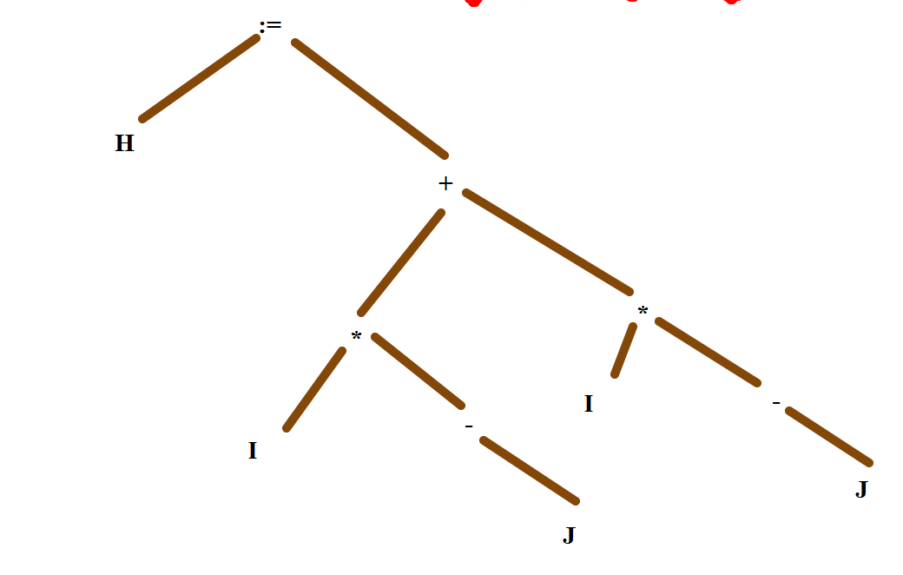
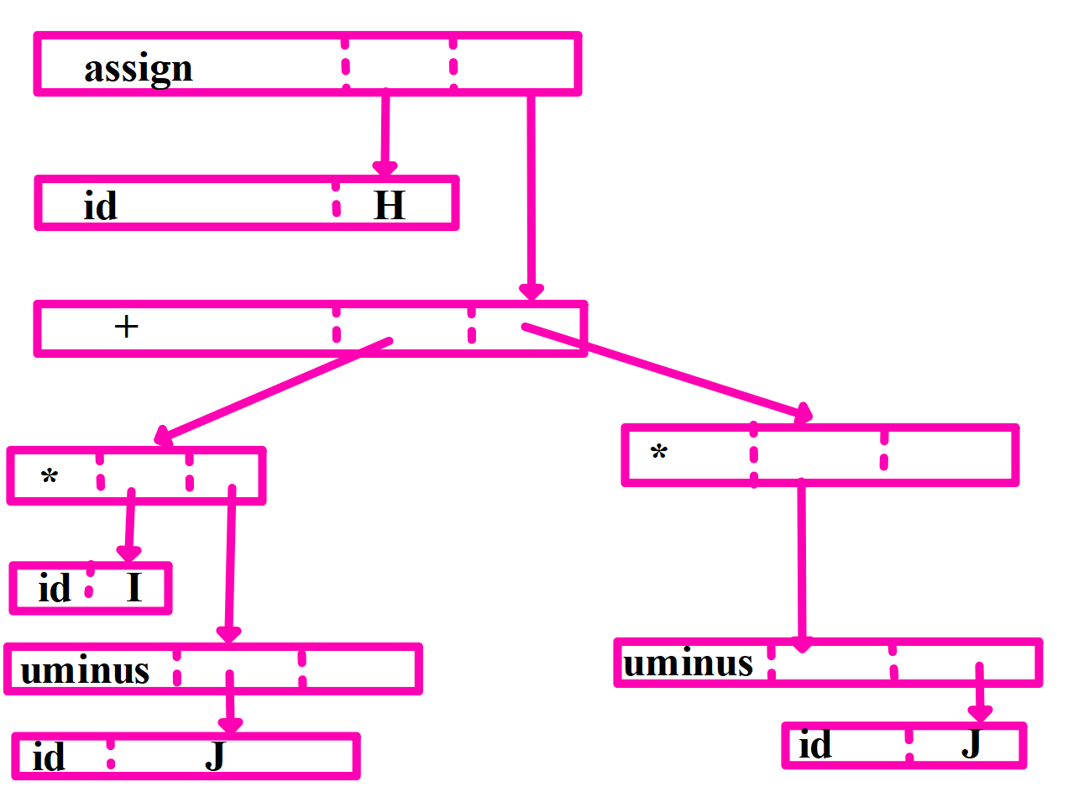
A+B

Slide 7
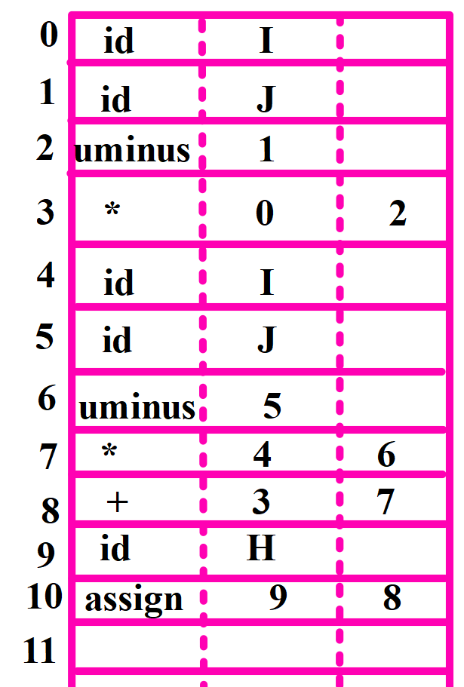

Slide 8
Three -Address Code
General Form
X:=Y op Z
X,Y,Z => Names,constants,compiler-generated temporaries
op => Any operator
Fixed or floating- point arithmetic operator, logical operator or boolean operator
Example
t1:=Y*Z
t2:= X+t1

Slide 9
Code for syntax tree
t1:=-J
t2:=I*t1
t3:=-J
t4:=I*t3
H:=t2+t4

Slide 10
Code for DAG
t1:=-J
t2:=I*t1
t5:=t2+t2
H:=t5

Slide 11
Types of Three-Address Statement
Assignment Statement
General Form
x:=y op z
op is binary arithmetic or logical operation
Assignment instruction of the form
x:=op y where
op is a binary operation
Binary operation => Unary minus,logical negation, shift operator, conversion operation( int to float)
Copy statement of the form
x:=y
where the value of y is assigned to x
X:=+Y
X:=+1

Slide 12
Unconditional jump
goto L
Three- address statement with label L is the next statement to be executed
Conditional jumps such as
if x relop y goto L
Applies relational operator (<,>,<=,>=,=) to x and y and executes the statement with label L
if x stands in relation relop to y
Else:
if x relop y goto L is executed next as in the usual sequence

Slide 13
param x and call p , n for procedure calls and return y representing a returned value is optional
param x1
param x2
……………
param xn
call p,n
p(x1,x2,..xn)
n => No. of actual parameters in call p,n

Slide 14
Indexed Assignments of the form
x:=y[i] and
x[i]:=y
Sets the contents of the location i units beyond x to the value of y
x,y,i => Data objects
Address and pointer assignments of the form
x:=& y
x:=*y
*x:=y
x:=& y
Set value of x to location of y
x:=*y
y is a pointer or temporary whose r-value is a location
r- value of x is made equal to contents of that location

Slide 15
*x:=y
Sets the r- value of the object pointed to by x to the r-value of y
Implementations of Three- Address Statement
Three- Address Statements can be implemented as records with fields for the operator and operand.
Quadruple
Triple
Indirect Triples

Slide 16
Quadruple
Record structure with four fields - op ,arg1,arg2 and result
General Form
x:=y op z is represented by placing y in arg1, z in arg2 and x in result
t1:=-J
t2:=I*t1
t3:=-J
t4:=I*t3
t5:=t2+t4
H:=t5
Loc | op | arg1 | arg2 | result
(0) | uminus | J |  | t1
(1) | * | I | t1 | t2
(2) | uminus | J |  | t3
(3) | * | I | t3 | t4
(4) | + | t2 | t4 | t5
(5) | := | t5 |  | H
H:= I *- J + I * - J

Slide 17
Triples
t1:=-J
t2:=I*t1
t3:=-J
t4:=I*t3
t5:=t2+t4
H:=t5
Loc | op | arg1 | arg2
(0) | uminus | J
(1) | * | I | (0)
(2) | uminus | J
(3) | * | I | (2)
(4) | + | t2 | (3)
(5) | := | H | (4)
H:= I *- J + I * - J

Slide 18
Other forms of Triples
Loc | op | arg1 | arg2
(0) | []= | x | i
(1) | assign | (0) | y
x[i]=y
Loc | op | arg1 | arg2
(0) | =[] | y | i
(1) | assign | x | (0)
x:=y[i]

Slide 19
Indirect Triples
Loc | Statement
(0) | (14)
(1) | (15)
(2) | (16)
(3) | (17)
(4) | (18)
(5) | (19)
Loc | op | arg1 | arg2
(0) | uminus | J
(1) | * | I | (14)
(2) | uminus | J
(3) | * | I | (16)
(4) | + | t2 | (17)
(5) | := | H | (18)
t1:=-J
t2:=I*t1
t3:=-J
t4:=I*t3
t5:=t2+t4
H:=t5

Slide 20
(x+y)*(y+z)+(x+y+z)
t1=x
t2=y
t3=t1+t2
t4=z
t5=t2+t4
t6=t3*t5
t7=t3+t4
t8:=t6+t7

Slide 21
Quadraple
Loc | op | arg1 | arg2 | result
(0) | := | x |  | t1
(1) | := | y |  | t2
(2) | + | t1 | t2 | t3
(3) | := | z |  | t4
(4) | + | t2 | t4 | t5
(5) | * | t3 | t5 | t6
(6) | + | t3 | t4 | t7
(7) | + | t6 | t7 | t8
t1:=x
t2:=y
t3:=t1+t2
t4:=z
t5:=t2+t4
t6:=t3*t5
t7:=t3+t4
t8:=t6+t7

Slide 22
Triple
t1:=x
t2:=y
t3:=t1+t2
t4:=z
t5:=t2+t4
t6:=t3*t5
t7:=t3+t4
t8:=t6+t7
Loc | op | arg1 | arg2
(0) | := | x
(1) | := | y
(2) | + | t1
(3) | := | z
(4) | + | t2 | (3)
(5) | * | t3 | (4)
(6) | + | t3 | (3)
(7) | + | t6 | (6)
(0) (20)

Slide 23
Indirect Triple
Loc | op | arg1 | arg2
(0) | := | x
(1) | := | y
(2) | + | t1 | (15)
(3) | := | z
(4) | + | t2 | (17)
(5) | * | t3 | (18)
(6) | + | t3 | (17)
(7) | + | t6 | (20)
t1:=x
t2:=y
t3:=t1+t2
t4:=z
t5:=t2+t4
t6:=t3*t5
t7:=t3+t4
t8:=t6+t7
Loc | Statement
(0) | (14)
(1) | (15)
(2) | (16)
(3) | (17)
(4) | (18)
(5) | (19)
(6) | (20)
(7) | (21)

